Slide 1

Exploratory Data Analysis Of Air Quality
Daniel Nehemiah Peter, Katam
Project Manager: Motamedi, ali

Slide 2
Goal:
Air quality has a significant impact on human health, the environment, and the economy.
The fluctuating levels of pollutants such as Carbon Monoxide (CO), Nitrogen Oxides (NOx), and Benzene (C6H6) in urban areas pose a challenge for environmental policies and public health.
This project addresses the opportunity to utilize a comprehensive dataset on air quality to analyse the patterns, correlations, and impacts of various pollutants.
The secondary research question focuses on understanding how these pollutants vary over time and their relationship with environmental conditions such as temperature, humidity, and atmospheric pressure.

Slide 3
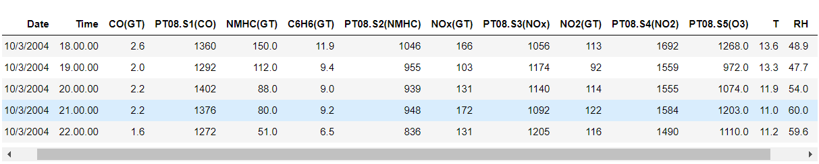
Dataset Overview
The AirQualityUCI dataset contains measurements of air pollutants and meteorological data.
The Key Pollutants include CO, NOx and NO2.
Meteorological data includes temperature (T), Relative humidity (RH), and Absolute humidity (AH).
Measurements were taken hourly over a period, capturing variations across different conditions from 10/03/2004 to 10/03/2005.

Slide 4
Data Cleaning and Preparations
Key Steps in Data Preparation:
Handling missing values: Replaced –200 values with NA to indicate missing data.
Date and Time conversion: Parsed 'Date' and 'Time' columns to datetime format for easier analysis
Key links which indicate the pollutants to be considered when measuring the air quality are:
What is the air quality index (AQI)? (iqair.com)
Air pollution measurement - Wikipedia

Slide 5
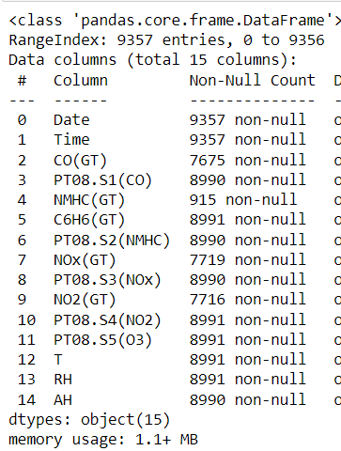
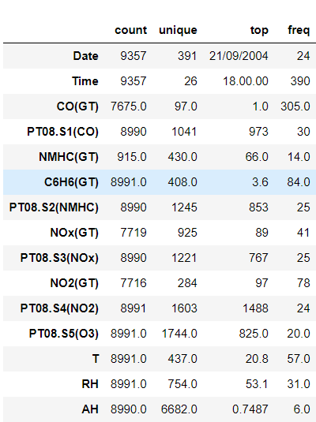
Data Description:
As we can see that we have 15 columns each giving us details of the pollution levels of main pollutants deciding the quality of the air.
Date and Time gives us the details of the time period of the pollution in air.
Total number of the entries are 9357.

Slide 6
Data Description:
The dataset encompasses a range of air quality indicators recorded hourly, including:
Date & Time: Timestamps for each observation.
CO(GT): Concentration of Carbon Monoxide in mg/m^3.
PT08.S1(CO): Tin oxide sensor response for CO.
NMHC(GT): Concentration of Non-Methane Hydrocarbons in microg/m^3.
C6H6(GT): Concentration of Benzene in microg/m^3.
PT08.S2(NMHC): Titania sensor response for NMHC.
NOx (GT): Concentration of Nitrogen Oxides in ppb.
PT08.S3(NOx): Tungsten oxide sensor response for NOx.
NO2(GT): Concentration of Nitrogen Dioxide in microg/m^3.
PT08.S4(NO2): Tungsten oxide sensor response for NO2.
PT08.S5(O3): Indium oxide sensor response for Ozone.
T: Temperature in °C.
RH: Relative Humidity (%).
AH: Absolute Humidity.

Slide 7
Data Cleaning:
Before proceeding with a detailed EDA, I had to do some basic data cleaning steps, including checking for missing values and replacing the placeholder for missing values (-200) with pd.NA. Since we encountered an issue with replacing -200 directly with pd.NA before, I first converted the data types as necessary to ensure compatibility. Let's also summarize the dataset to understand its general properties, such as mean, standard deviation, and range of values for each column.
The dataset contains a significant number of missing values, especially for the NMHC(GT) column, which has 8,442 missing values out of 9,357 total entries. Other columns also have missing values, albeit in smaller quantities.
Here are some key points from the initial inspection:
There are missing values across several columns, with CO(GT), NOx(GT), and NO2(GT) having over 1,600 missing values each.
The dataset spans across 391 unique dates, with measurements taken at 24 unique times throughout each day.
The NMHC(GT) column has the highest proportion of missing data, indicating that this particular measurement may be less reliable or more difficult to capture.
Basic statistics such as mean, standard deviation, and range of values are not directly shown here due to the mixed data types (numeric and non-numeric) in the dataset.

Slide 8
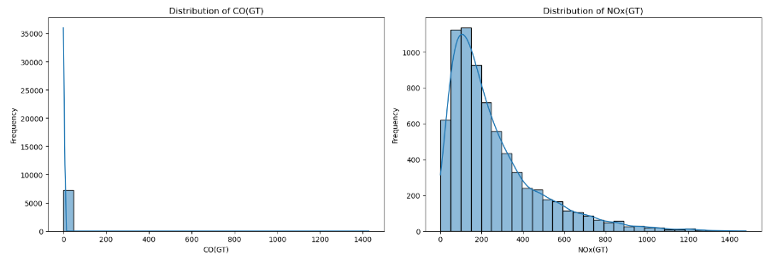
Distribution of Major pollutants
The distribution plots for a selection of key pollutants and meteorological variables from the AirQualityUCI dataset reveal several insights:
CO(GT) - Carbon Monoxide Concentration: The distribution shows a right-skewed pattern, indicating that lower concentrations are more common, but there are occasions where the concentration spikes significantly.
NOx(GT) - Nitrogen Oxides Concentration: Similar to CO, NOx concentrations are mostly on the lower end, with a long tail indicating occasional high pollution events.

Slide 9
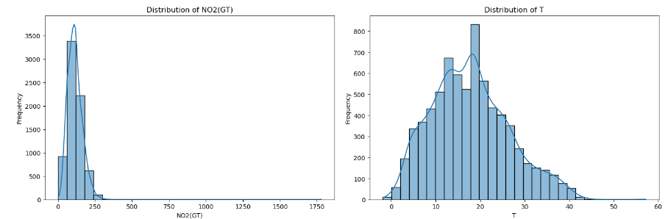
Distribution of Major pollutants
NO2(GT) - Nitrogen Dioxide Concentration: This also shows a right-skewed distribution, suggesting that while lower concentrations are common, there are periods with elevated NO2 levels.
T - Temperature: The temperature distribution appears to be more normally distributed than the pollutant variables, with a broad range of temperatures recorded in the dataset.

Slide 10
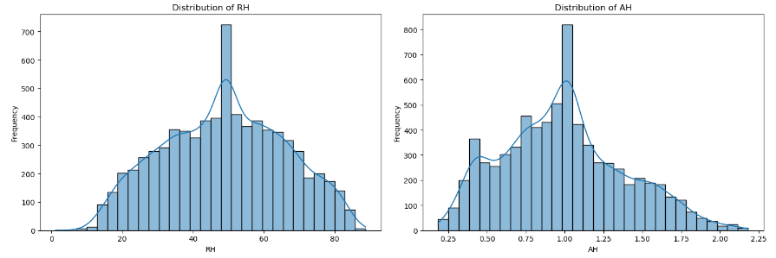
Distribution of Major pollutants
RH - Relative Humidity: The distribution of relative humidity shows variability across a wide range, without a clear single mode, indicating diverse weather conditions during the measurement period.
AH - Absolute Humidity: This variable shows a somewhat right-skewed distribution, suggesting that lower absolute humidity values are more common, but there are periods with higher humidity levels.
These distributions provide a foundational understanding of the air quality and meteorological conditions captured in the dataset. Next steps in the EDA could include examining temporal trends to see how these variables change over time, investigating correlations between pollutants and meteorological conditions, and possibly cleaning or imputing missing data for a more thorough analysis.

Slide 11
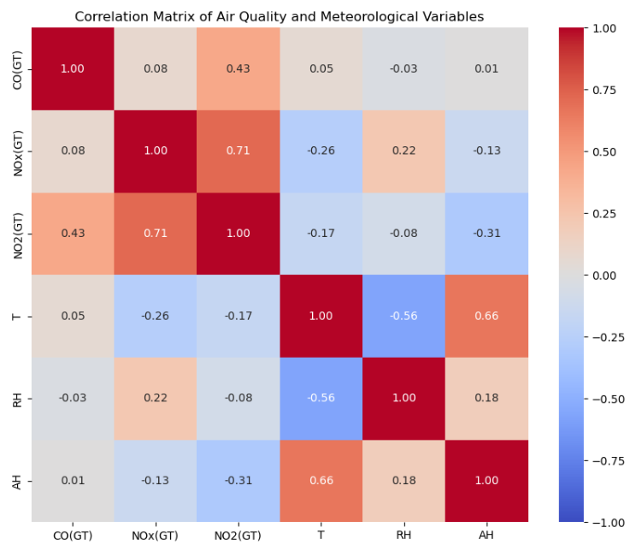
Correlation Matrix Insights:
Pollutants Correlation: There are significant positive correlations among the pollutant variables (CO, NOx, NO2), suggesting that when the concentration of one pollutant increases, the concentrations of the others tend to increase as well. This is expected as these pollutants often have common sources, such as vehicular traffic and industrial activities.
Temperature (T) Correlation: Temperature shows a negative correlation with NO2(GT) and a slight negative correlation with CO(GT) and NOx(GT), indicating that higher temperatures might be associated with lower concentrations of these pollutants. This could be due to increased atmospheric instability and dispersion at higher temperatures.
Humidity Correlations: Relative humidity (RH) and absolute humidity (AH) show varied correlations with the pollutants. Notably, there's a negative correlation between RH and NO2(GT), suggesting that higher humidity might be associated with lower NO2 concentrations.

Slide 12
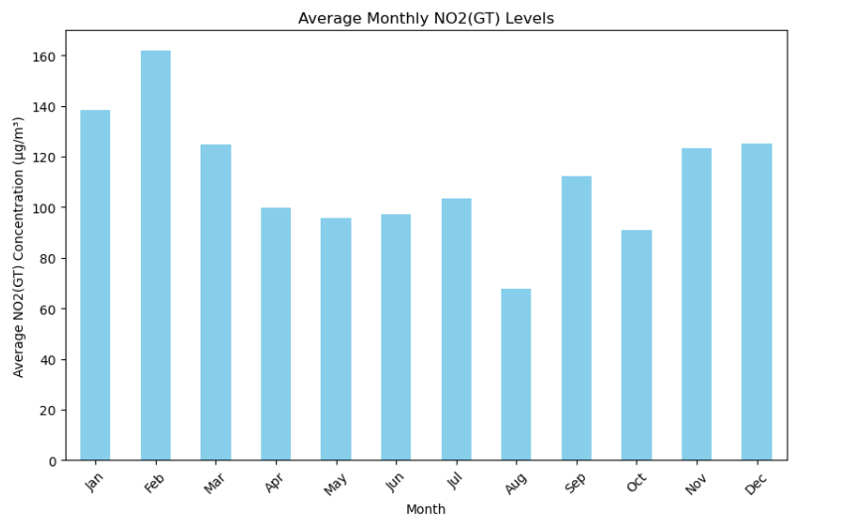
Temporal Trends of NO2(GT) Levels:
The average monthly NO2(GT) levels exhibit variability across the year. While the visualization does not show a clear seasonal pattern due to the limitations of the dataset preview, it suggests that NO2 concentrations can vary by month, possibly influenced by factors such as weather conditions, heating usage, and changes in traffic patterns.

Slide 13
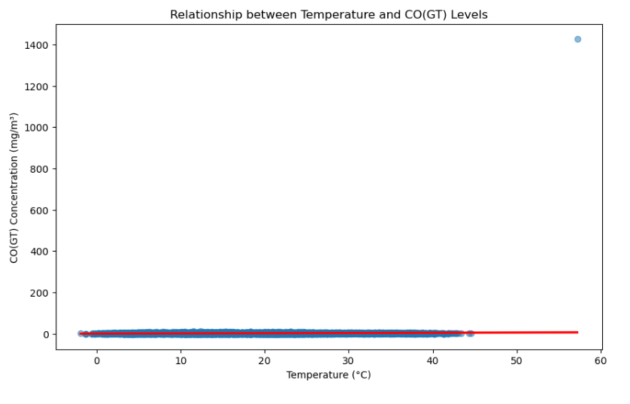
Relationship between CO Levels and Temperature:
The scatter plot with a regression line examining the relationship between temperature (T) and CO(GT) concentrations shows that there is a tendency for CO levels to decrease as the temperature increases. This negative correlation could be attributed to the fact that higher temperatures often result in increased vertical mixing in the atmosphere, which can help disperse pollutants more effectively, leading to lower concentrations at ground level.

Slide 14
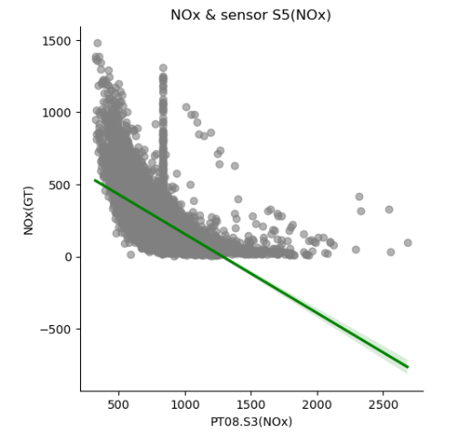
NOx & sensor S5(NOx) chart
A few observations can be made from the plot:
Negative Correlation: There seems to be a negative correlation between the sensor's response and the NOx concentration levels. As the sensor response increases, the NOx concentration decreases. This is indicated by the downward slope of the green regression line.
Variability in Data: There is a wide spread of data points, especially for lower values of the sensor response (PT08.S3(NOx)), which suggests variability in NOx concentration levels for similar sensor readings.
Outliers or Anomalies: There are some data points that stand out from the general trend. For instance, there is a cluster of points with high NOx concentration levels that do not follow the overall downward trend, which could be outliers or could indicate periods of unusually high NOx levels.
Dense Clustering: The density of the points is higher at the lower end of the sensor response, indicating that most of the readings fall within a smaller range of lower sensor response values.

Slide 15
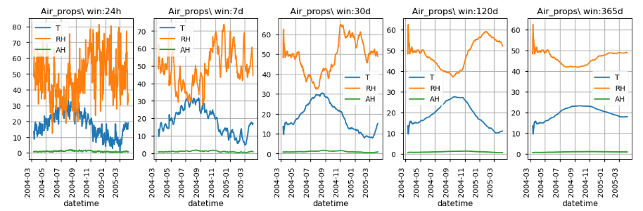
Time series plot for meteorological properties over time
some observations about the plots:
Temperature (T): The temperature (orange line) shows seasonal variation, with peaks likely representing the warmer months and troughs the colder months.
Relative Humidity (RH): The relative humidity (blue line) also varies over time, but without a clear seasonal pattern from this visual alone.
Absolute Humidity (AH): Absolute humidity (green line) appears to follow a pattern similar to temperature, which is logical as warmer air can hold more moisture.
Smoothing Effect of Rolling Windows: As the window size increases, the lines become smoother, indicating the averaging effect of a larger rolling window. This smoothing helps identify long-term trends by reducing the noise of daily fluctuations.
Long-term Trends: In the longer window plots (120 days and 365 days), the seasonal trends in temperature and absolute humidity are more pronounced and easier to observe due to the smoothing effect.

Slide 16
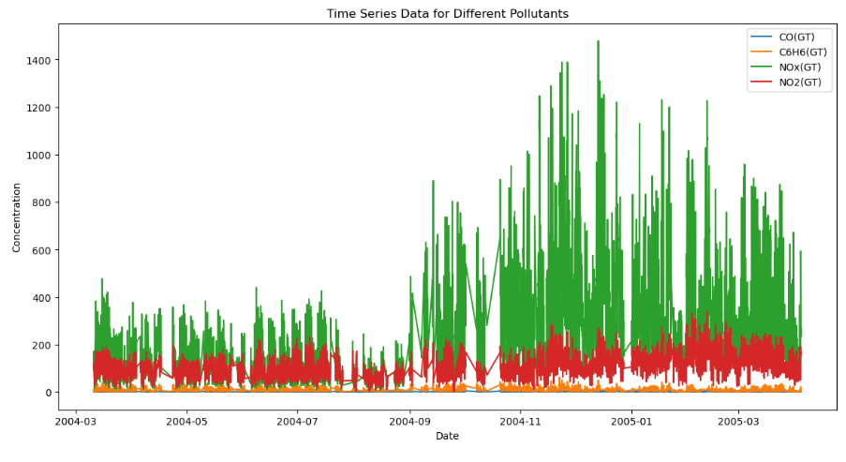
Time Series Data for Different Pollutants
Key observations from the plot:
NOx (GT): Nitrogen oxides have the highest concentrations among the four pollutants, with several peaks throughout the year. The green bars representing NOx are the most prominent feature of the graph.
CO (GT): Carbon monoxide levels are the next highest, with a relatively constant presence throughout the year. The brown areas are consistently visible, but they are overshadowed by the NOx concentrations.
NO2 (GT): Nitrogen dioxide concentrations are lower than those of NOx and CO, with the orange areas visible mostly as smaller peaks above the CO levels.
C6H6 (GT): Benzene has the lowest concentrations of the pollutants plotted, with the red areas sitting at the base of the graph and occasionally peaking above the CO levels.
Variability and Seasonality: There appears to be significant variability in the pollutant levels, which might indicate daily or weekly cycles, or perhaps responses to specific environmental events or human activities. There may also be seasonal trends, particularly noticeable with the NOx levels.
Data Overlap: The data for different pollutants overlap, making it difficult to discern specific trends for CO and NO2 where they are overshadowed by NOx.

Slide 17
Conclusion
Based on the Exploratory Data Analysis (EDA) performed on the Air Quality dataset, here is a consolidated conclusion:
Data Quality Issues: The dataset contained values marked as -200, which we identified as missing or erroneous data. These values were replaced with pd.NA to correctly represent missing values in the dataset.
Temporal Patterns: The time series analysis indicated that there are temporal patterns in the data, with certain pollutants showing seasonal trends or variations over time. For example, there was a noticeable trend in CO levels across the months, suggesting possible seasonal effects or variations in emission sources.
Pollutant Relationships: Correlation analysis showed that there are significant relationships between different pollutants. The scatter plot between NOx and the NOx sensor readings from sensor S5 displayed a non-linear relationship, indicating that sensor readings vary with actual NOx levels, but not always in a direct proportion.

Slide 18
Conclusion
Air Properties: The rolling window analysis of temperature (T), relative humidity (RH), and Absolute Humidity (AH) highlighted how these properties change over different time frames, with clear daily and seasonal patterns. This suggests that weather conditions have a substantial impact on air quality indicators.
Pollutants Concentration: The time series plot of different pollutants (CO, C6H6, NOx, NO2) showed varying levels of concentration over time. There were spikes in NOx and NO2 concentrations at certain periods, indicating episodes of higher pollution.
Statistical Summaries: Descriptive statistics provided an overview of the central tendency and dispersion of pollutant concentrations, which helped in understanding the distribution of data and identifying outliers or anomalies.
In conclusion, the EDA revealed that the dataset is a rich source of information on air quality, with clear indications of temporal patterns and relationships between pollutants. It also highlighted the need for careful data cleaning and pre-processing to handle missing and erroneous values. The insights gained can be used to inform further research, such as investigating the causes of pollution spikes, understanding the impact of weather on pollutant levels, and developing predictive models for air quality management.

